Slide 1

TASK ON
Code Refactoring and Bug Fixing
NAME- MITRABHANU PANDA
INTERN ID -IN1241006

Slide 2

INTRODUCTION TO THIS TASK
Refactor the existing codebase and ensure the proper functioning of the Note Taking Application.

Slide 3
SUMMARY ABOUT THE TASK
A code files is given with some Bugs. Our task is to convert this File Bug Free and See this Code file work perfectly or not.
There are two files given to me:
Flask Code File (APPLICATION SERVER)
HTML Templates File

Slide 4
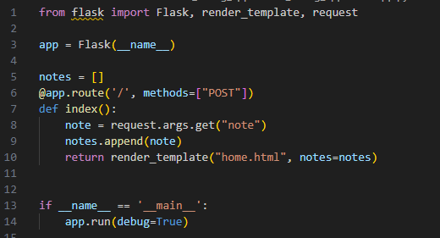
FINDING THE BUG IN APPLICATION SERVER
Method is set to be “POST”. “POST” method used to write data using request.
Here data is not transfer using URL. Data is Transfer using HTML from element.

Slide 5
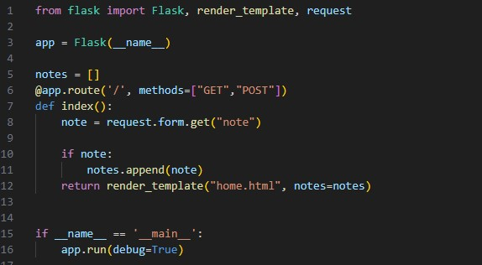
FIXING THE BUG IN APPLICATION SERVER
To add “GET” also in method parameter of route in python Flask application Server.
To read data from HTML Form element using request.form.get(“note”)
If we receive any empty data means it also add with existing Notes. In order to avoid empty data we have to check for notes if it is not empty then add to our database.

Slide 6
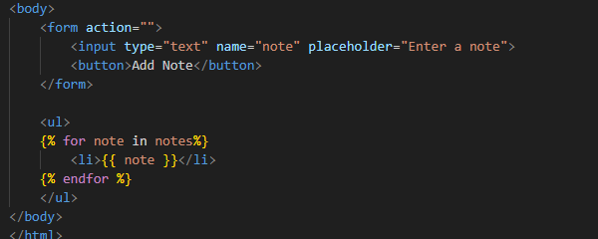
BUG IN HTML TEMPLATE
In Form Element Method is missing.
In button tag type parameter is missing.

Slide 7
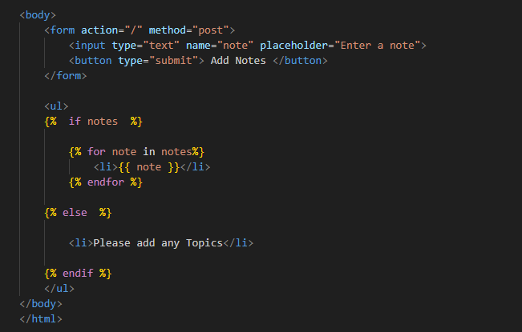
FIXING BUG IN HTML TEMPLATES
Fill Method = “post” in the form element.
Fill type = “submit” in button tag.
If our notes database is empty then its show “Please add any Topics”.

Slide 8
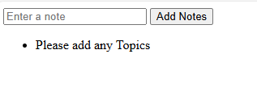
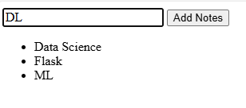
FINAL OUTPUTS AFTER FIXING

Slide 9
THANK
YOU

